Slide 1
Industrialization Powerpoint Review Questions-Chapter 6 Review both your packet and this powerpoint test October 25th and 26th

Slide 2
What significant impact did the first revolution have on the world?

Slide 3
Transforming the agrarian and rural society to industrial and urban

Slide 4
What resource was used for building bigger bridges and taller buildings, and rails for railroads?

Slide 5
Steel

Slide 6
Which term explains the greatly increased output of machine made goods that began in England during the 18th century and the US in the 19th century?

Slide 7
Industrial revolution

Slide 8
What industry was the first to industrialize?

Slide 9
the textile industry

Slide 10
What is the name of the steel-making process in which carbon, and other impurities are removed from molten iron and added air

Slide 11
The Bessemer Process
By Henry Bessemer

Slide 12
What were 5 of the major uses of steel during the second industrialization which had a great impact on the US?

Slide 13
Railroad tracks, barbed wire, farming machines, steel cables (used for building bridges, and skyscrapers

Slide 14
Who used a steam engine to drill for oil which later lead to the use of kerosene and gasoline?

Slide 15
Edwin L. Drake

Slide 16
Who invented safety elevators to assist in the construction of skyscrapers?

Slide 17
Harriet Tracy

Slide 18
What was the by product of crude oil which lead to the advancement of fueling automobile?

Slide 19
Gasoline

Slide 20
Which inventor create a lubricating cup allowing the locomotive engine to be oiled without stopping the engine?

Slide 21
Elijah McCoy

Slide 22
Which invention created reliable transportation and westward expansion for businesses and people, which later inspired the country to increase their expansion.

Slide 23
How did Professor C. F. Dowd impact the railroad industry?

Slide 24
By creating a time zone to allow for efficiency of the railroad industry for scheduling purposes

Slide 25
What significant impact did George Pullman have on the United States of America?

Slide 26
Increased travel and tourism

Slide 27
Why did Alexander Graham Bell and Thomas Watson create the telegraph?

Slide 28
In hopes of finding a way to teach the deaf how to speak

Slide 29
What connection did Lewis Latimer and Thomas Edison have with the invention of the lightbulb?

Slide 30
Latimer- invented a way to allow the filament to last longer in a lightbulb.
Edison- used direct current to invent the use of the lightbulb explaining how electricity can better business practices

Slide 31
Who served as the major financial investor of businesses in financial debt and new inventors?

Slide 32
JP Morgan

Slide 33
What invention was created by Madame CJ Walker?

Slide 34
Straightening or Hot comb

Slide 35
Which invention was created to Christopher Scholes and which industry did it assist in advancing?

Slide 36
The typewriter and the business industry

Slide 37
What is the contrast between alternating and direct current of electricity?

Slide 38
Alternating reverses its direction many times a second and regular intervals, while direct only flows in one direction

Slide 39
Who was first crediting with introducing electricity and later lost financial funding ?

Slide 40
Nikolas Telsa

Slide 41
What were two advantages of nuclear power according to President Dwight D. Eisenhower?

Slide 42
To advance medicine, agriculture, and other industries
as an abundant power source

Slide 43
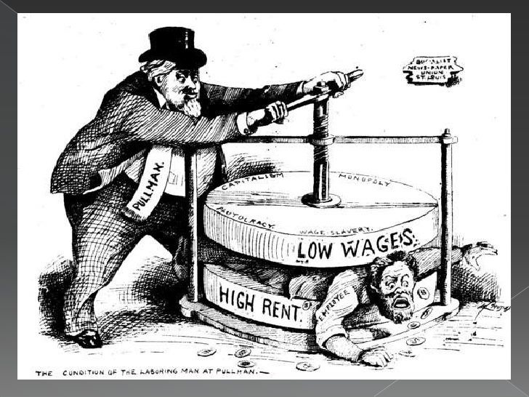
What is the main idea of this political cartoon?

Slide 44
Pullman gained control of his employees by requiring high rents yet issuing low wages.

Slide 45
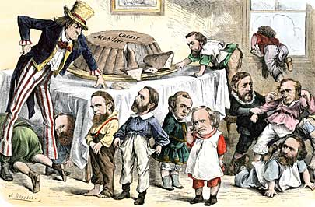
What is the main idea of this political cartoon?

Slide 46
Several congressional members were reprimanded by the US government for their connections to the Credit Mobilier

