Slide 1
Federalism Emergency management
Chapter 4

Slide 2
Today’s focus
Objective: What does emergency management have to do with federalism?
Warm up question: Prior to a natural disaster, who if anyone, should be responsible for the preparedness of state or city? ( Explain why?)

Slide 3
What is emergency management?
Challenges faced?
should the states be responsible for paying for disaster response?
Red tape
Resources?
Effectiveness to coordinate and deliver supplies
State government officials giving the okay to accept relief
Effective communication to on-site relief organizations of persons
Funding
Preventative measures
Public information
Clean up recovery plan
Medical care
Needs (survival supplies)

Slide 4
What is the role of a governor? $130,273 annually
requirements
Roles
30 yrs of age
Lived in state for 7 yrs prior to the election
Fl ( gov and lt.gov ) run together – same as potus and vp ( general elections)
4 year terms if elected, 2 term limit gov. only( same as potus)
Us citizenship
Implementing state laws
Overseeing state operations
Implement and revise policies and programs
Work with state depts. And agencies
Grant reprieve, commute, and pardon
Use line-item veto
Reprieve
Daily operations of the state during normalcy and emergency preparedness

Slide 5
Governor’s press briefing
See mrs. Tomlinson’s Youtube channel
Unit 2
Governor Christie Press Briefing In Pompton Lakes On Hurricane Sandy

Slide 6
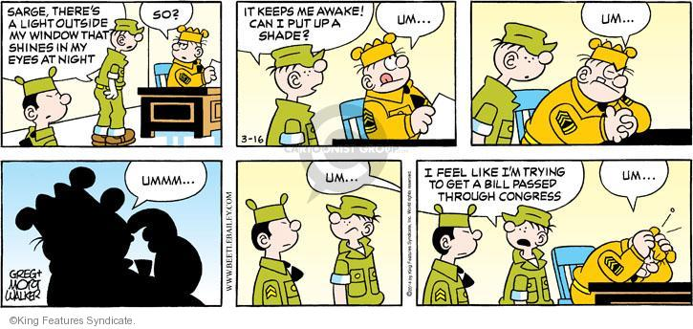
What is red tape?

Slide 7
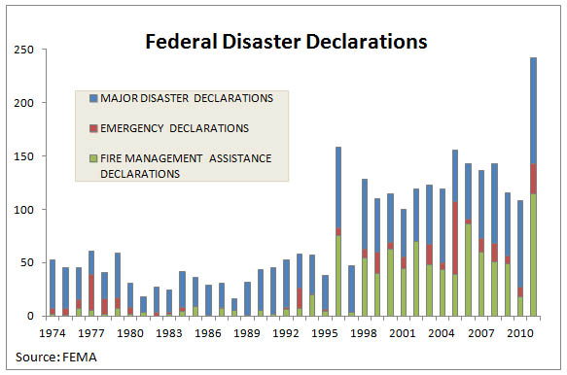
Analyzing the graph below, what trends are you able to uncover regarding money issued to states?

Slide 8
According to the cato institute study by garrett and sobel…
Every state representative who sits on the disaster relief oversight committee receives ______ million in additional funding when a disaster is declared
Many say it is often related by politics rather than by need of the actual state.
Most declarations are for rain, snow, and mundane weather events.
Cato institute, 2012

Slide 9
What trends can you potentially identify?
After examining all disasters from 1991 to 1999, a comprehensive study by Garrett and Sobel found that states politically important to the president in his reelection bid have a significantly higher rate of disaster declaration. Recent data confirm the continuation of this political manipulation.
In 1996, when Bill Clinton was up for reelection, he set a record by declaring the largest number of major disasters in history: 75. Unsurprisingly, the second-highest year for disasters in history was 2004, George W. Bush’s reelection year, when he declared 68. Ninety percent of the increase in disasters declared between 2003 (a nonelection year) and 2004 were in the 12 battleground states where the election was decided by 5 percent or less.
The year with the largest number of disasters declared during George H. W. Bush’s administration was also the year he was up for reelection, and this holds true for Ronald Reagan as well. Other striking individual examples abound, including a two-foot snowstorm in Ohio (a state that went for Bush), which netted that state disaster relief during the 2004 election year, while Wisconsin (a state that went for Kerry) was denied disaster relief in 2005 in the aftermath of a major tornado.

Slide 10
How does red tape potentially impact the effectiveness of emergency management?
The Red Cross “begged to be allowed to go [into New Orleans]” to distribute essential relief supplies but was prevented by government officials from doing so. FEMA confiscated critical emergency supplies, shipped by the hospital’s out-of-state private owner to assist the hospital’s 137 remaining patients, while the supplies were in transit to Methodist Hospital in New Orleans. “Those supplies were in fact taken from us by FEMA, and we were unable to get them to the hospital,” one hospital representative remarked. To avoid FEMA’s confiscatory actions, the owner sent a second shipment to Lafayette (130 miles from New Orleans) and had a private helicopter fly it directly to the rooftop of the hospital in New Orleans.

Slide 11
How does red tape potentially impact the effectiveness of emergency management?
Perhaps the most stunning example of how a centralized federal bureaucracy is inherently ill-equipped to coordinate the direction of relief resources is what has become known as the “odyssey of the ice.” FEMA ordered 182 million pounds of ice to be delivered to stranded families and aid workers. Yet some of the ice ended up in Portland, Maine, more than 1,500 miles away from the disaster area. The cost of shipping and storing the 200-plus truckloads of the Portland-bound ice was $275,000…
A truckload of ice even ended up at the Reid Park Zoo in Tucson, Arizona. The driver of the ice truck got so many conflicting commands from government relief officials that he ended up traveling through 22 states without ever delivering a single bag of ice to a hurricane victim. Instead, he ended up donating it to the Tucson zoo to be enjoyed by the polar bears.

Slide 12
What is the role of a disaster response committee?
Go to mrs. Tomlinson’s you tube channel
Unit2 and watch video titled below
Hurricane Wilma Video - Miami Beach, Florida

Slide 13
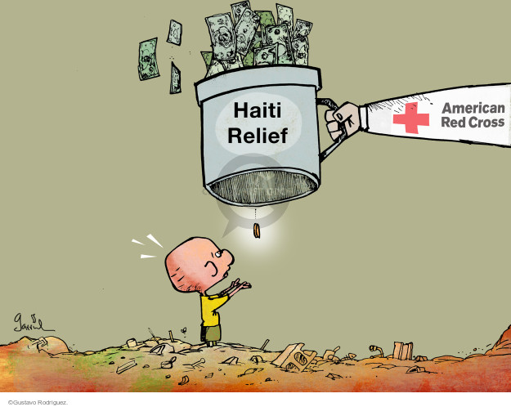
Considering our hurricane Matthew reading and this political cartoon, how might Haiti’s recover effect be impacted?

Slide 14
What is fema exactly?
Take notes:
What does FEMA stand for?
What is the role of fema?
a. List the roles of fema
When was it created?
Visit mrs. Tomlinson’s you tube channel
Go to unit 2 and look for title below and watch
President of National Emergency Management Agency on FEMA

Slide 15
Exit Slip
On a separate sheet of paper list the following:
3 things you remember about our lesson on federalism and emergency management
2 things you believe may prevent the government from providing direct aid to it’s people
1 question you still have regarding federalism’s role in emergency management.

